Slide 1

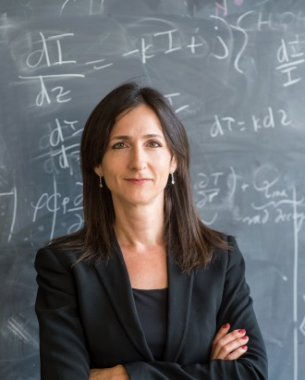
Harvard Origins of Life Initiative
Third Annual Prize Lecture
Wednesday, September 19 @ 4PM
Professor Sara Seager
Professor of Planetary Science, Physics and Aerospace Engineering
Massachusetts Institute of Technology
“Exoplanets and the Search for Biosignature Gases:
An Astronomer’s Journey through Chemical Space””
Lecture: Agassiz Theatre, 5 James Street, Cambridge
Reception to follow at 5:30PM at in the Horner Room at Agassiz Theatre
For more information and to RSVP please contact Kelly Colbourn-Moreno, Associate Director at 617-495-1451 or at kelly.moreno@cfa.harvard.edu

